Slide 1
MIPS32 Instructionset
from opencores.org
571 System Verilog Final Project
Edgar Rosales, Francois Toguo Fotso, Hoa Quach

Slide 2
opencores.org
http://opencores.org/project,mips32r1

Slide 3
Verilog to System Verilog
always @(posedge) to always_ff @(posedge)
always @(*) to always_comb
Used package to store common parameters
Changed some parameters to enum type
Changed design logic where x’s were assigned to registers/wires
Commented out all ‘default’ cases where x’s were used
Ports using x’s left unconnected

Slide 4
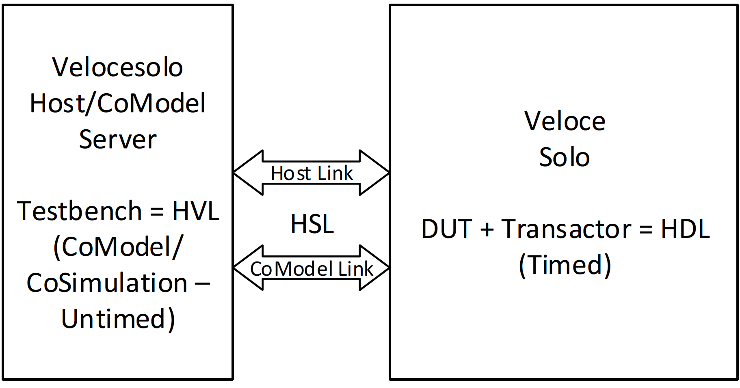
Veloce
TBX Mode
Original design did not synthesize
Complained about 4 State driven nets
Modified logic, now synthesizes

Slide 5
Instruction Decode Assertions
At posedge, both, original design and our assertion module decode instructions.
At negedge, we compare values and output proper error messages.

Slide 6
Pending Assertions
EX Stage
MEM Stage
WB Stage

Slide 7
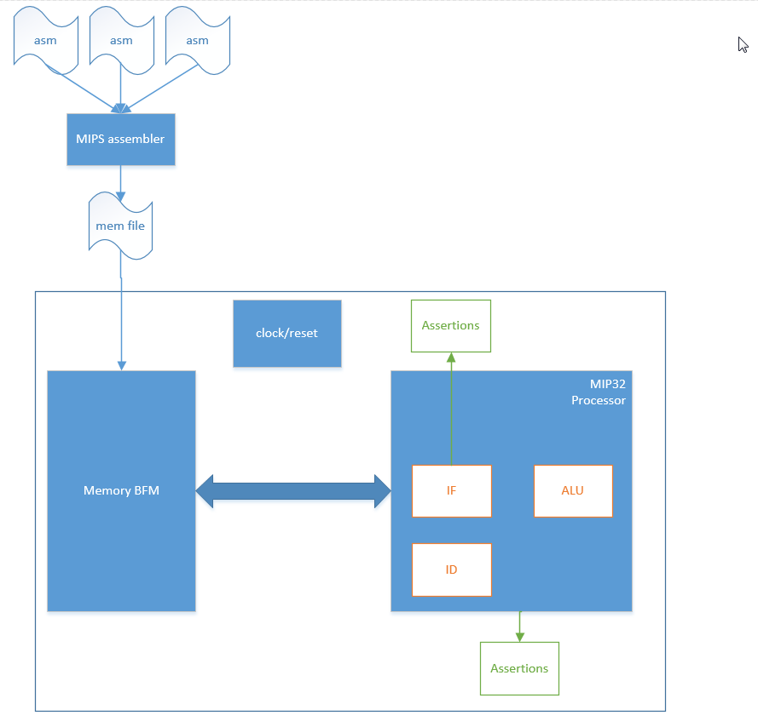
Top level

Slide 8
Assembly test cases
-Generated by converting functional hig level C code to MIPS assembly.
- MIPS assembly code reformated and ran trough an assembler (MIPS MARS4.5 simulator) to generate memory imae files containing HEX values
- test and expected results save in the image file
- image files loaded during simulation and feeded to the DUT
- 19 differents opcodes verified so far
- Memory test.

Slide 9
Verified Opcodes
addu
and
andi
beq
bne
bne
j
la
li
lw
move
nop
or
sll
slti
sra
srl
sw
syscall

